Slide 1

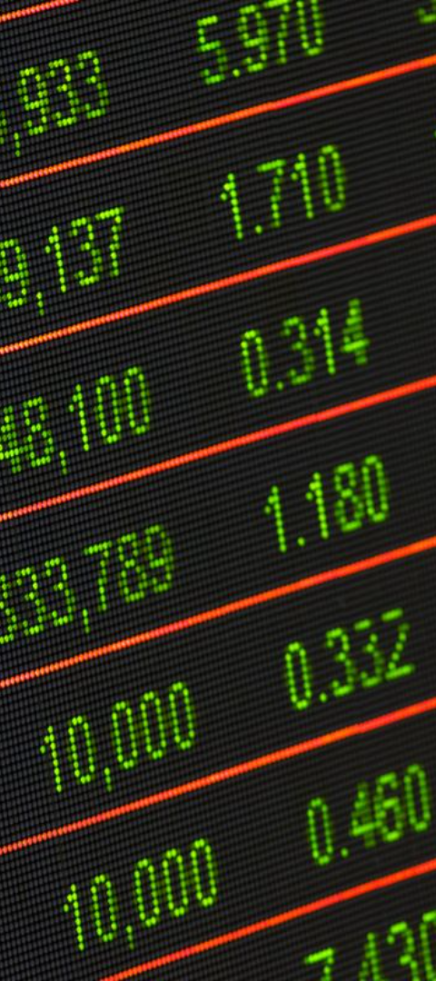
Efficient Frontier: Achieving Optimal Portfolio Performance
Discover the power of the efficient frontier in portfolio management to strike the perfect balance between risk and return, unleashing the potential for optimal performance.
Made by Group 4

Slide 2

Table of Contents
Introduction of Efficient Frontier
About the Risk & Return
The Graph of Efficient Frontier
Practical Issue We’re Solving
Find the objective function
Find the Minimum
Coding
Conclusion

Slide 3
Efficient Frontier
What is it?
Visualizing Risk & Return
Optimal Diversification
The efficient frontier is a graphical representation of all possible .
It helps investors understand the trade-off between risk and return, allowing them to identify the optimal portfolio for their investment goals.
By allocating their investments on the efficient frontier, investors can achieve the highest return for a given level of risk, or the lowest risk for a desired level of return.

Slide 4

Risk and Return
Risk
Return
Balancing
The uncertainty of achieving a desired investment outcome.
Return is the gain or loss on an investment.
The efficient frontier enables investors to evaluate how adjustments to their portfolio allocations affect the risk and return balance, allowing them to make informed decisions.
It encompasses market volatility, economic factors, and specific risks associated with individual assets.
Investors aim to maximize their returns while managing risk effectively.

Slide 5

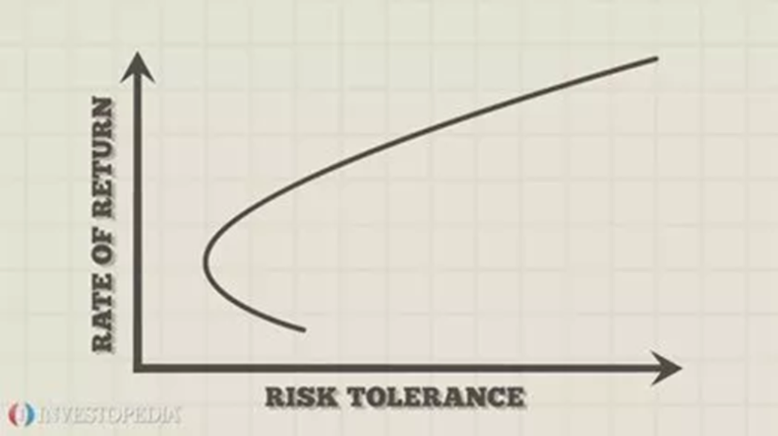
The Graph of efficient Frontier
reference：https://www.investopedia.com/terms/e/efficientfrontier.asp

Slide 6

Practical Issue We're Solving
We try to make use of efficient frontier to find the optimal portfolio.
Find the portfolio with the lowest risk
Find ideal portfolios with the most return given the same degree of risk
We analyzed the stock price of 7 prominent corporations over the past decade:
AAPL, ASML, GOOG, META, MSFT, NVDA, TSLA

Slide 7
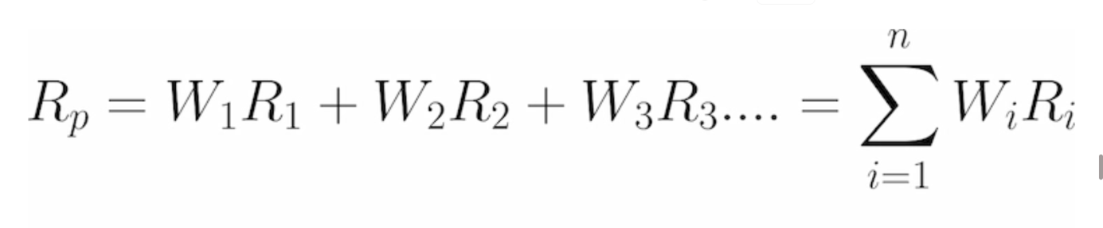
Draw the Efficient Frontier
caculate the expected values and standard deviation of the portfolio composed of random weight of stocks
how do we caculate the expected values of the portfolio?

Slide 8
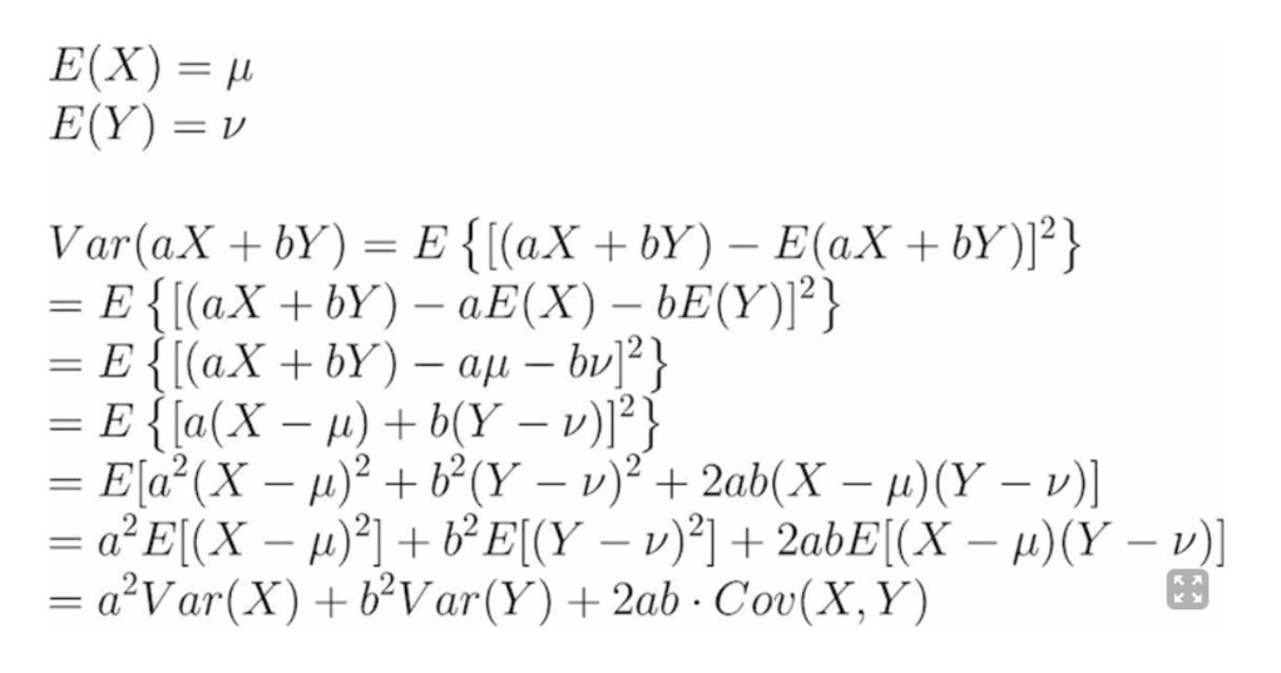
how do we caculate the standard deviation of the portfolio?

Slide 9

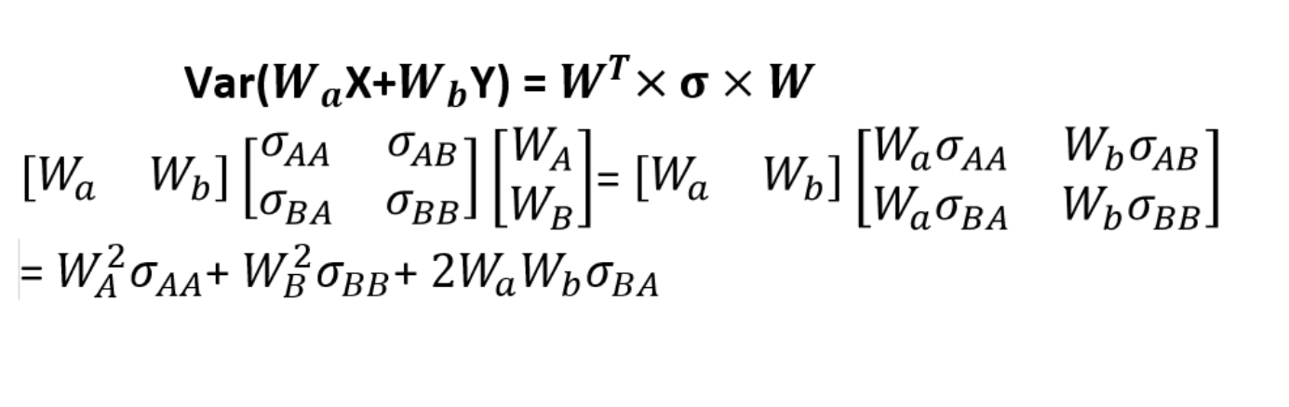
reference: https://vocus.cc/article/60f2edc4fd89780001629c67

Slide 10
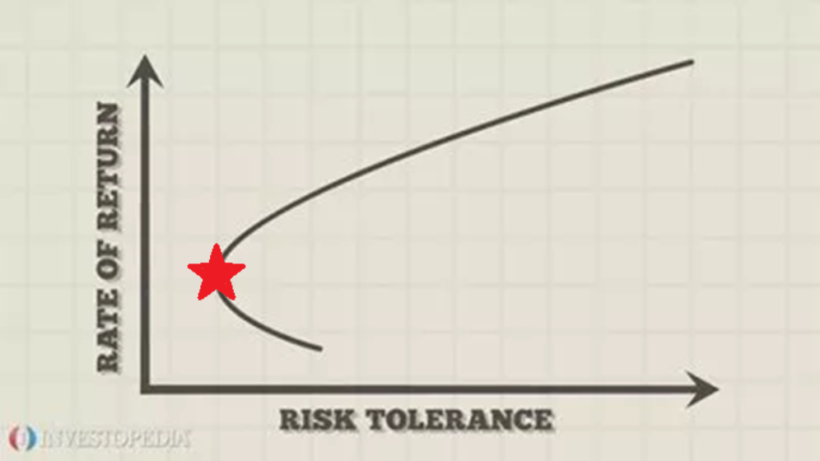
Using SLSQP to Find the Minimum
SLSQP (Sequential Least SQuares Programming) is an algorithm that can find the minimum of the function with several constraints
reference：https://www.investopedia.com/terms/e/efficientfrontier.asp

Slide 11

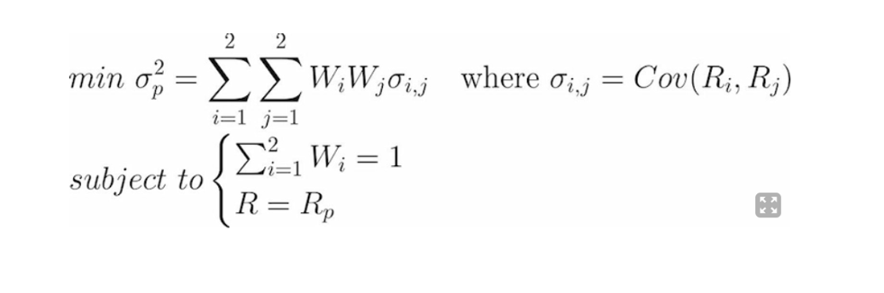
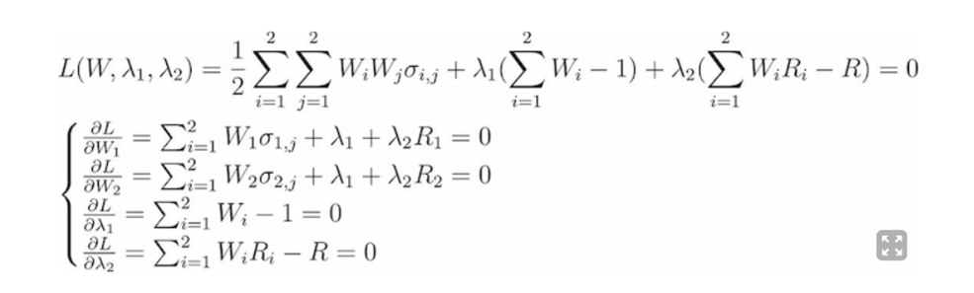
Lagrange Mutiplier
SLSQP is based on lagrange mutiplier and gradient descent.
In the example, there are four constraints as follows.
reference：https://vocus.cc/article/60f2edc4fd89780001629c67

Slide 12
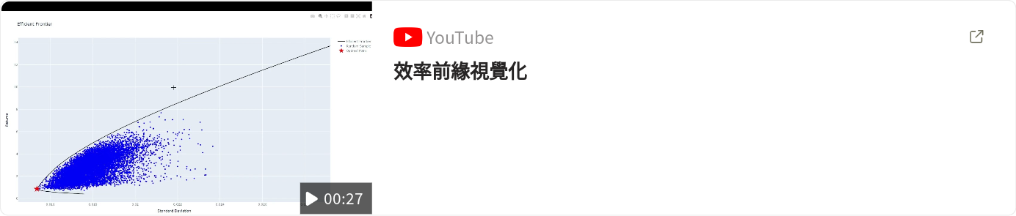
Visualization

Slide 13

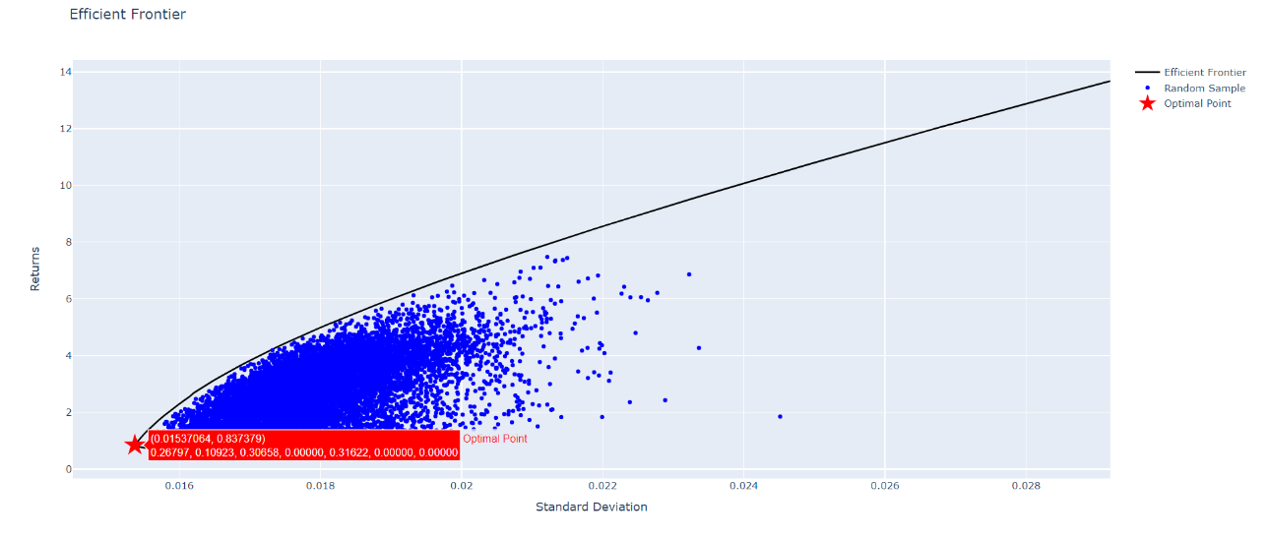
Graph Drawn by Code
We have some observations from this graph:
The curve formed by points at the edge
The point with minimum risk and minimum return
Points below efficient frontier

Slide 14

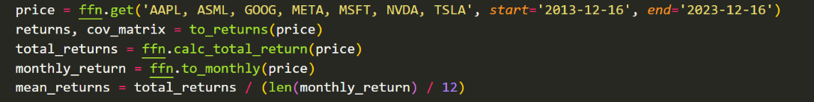
It's Coding Time
Fetch the historical Data and calculate the returns,
yearly returns, covariance matrix, etc.
define the objective function we have to minimized later
Set the constraint of the random sampling part

Slide 15

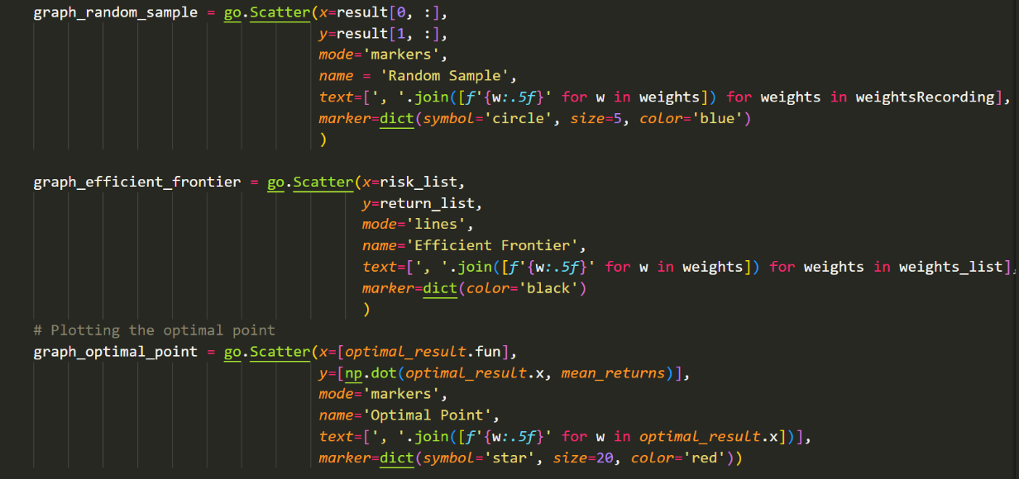
Solve it with the SLSQP method!
Use similar way to find the lowest risk for every possible returns That is, the Efficient Frontier

Slide 16
Thanks For Your Attention

